Slide 1
TRICKY JOBS

Slide 2
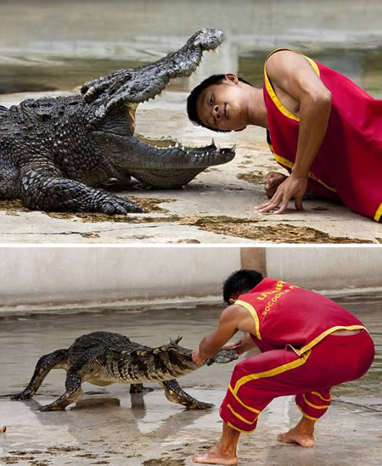
Tricky- something that is difficult to deal with or do because it is complicated
and full of problems.

Slide 3
dangerous
risky
hazardous
perilous

Slide 4
Bomb specialists
Lion trainers
Policemen
Truck drivers
Cashiers
Firefighters
Coast Guard Search and Rescue
Loggers
Miners
Fishermen
Bodyguards

Slide 5
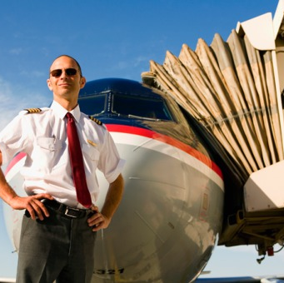
What are the most dangerous jobs in the world?

Slide 6
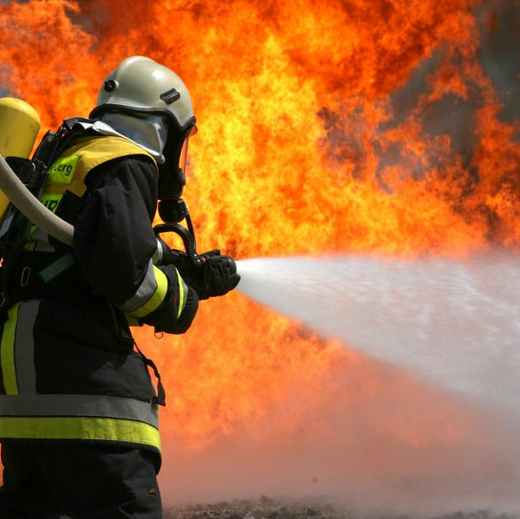
Firefighters
Firefighters kill the flames or run into a burning house to save children and animals. This work also includes rescuing people from car wreckage and dangerous places.

Slide 7
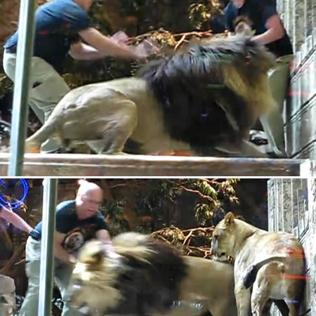
Lion trainers
Lion trainers face wild animals. The risk of bitten by huge lions is always available.

Slide 8
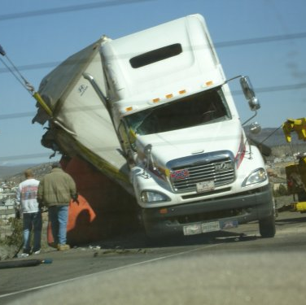
Truck drivers
Truck drivers are special individuals who live on the road. They face tough road conditions, reckless drivers and sleepless nights, which can all lead to tragic circumstances.

Slide 9
Cashiers
Cashiers deal with money, that’ s why many of them are shot every year.

Slide 10
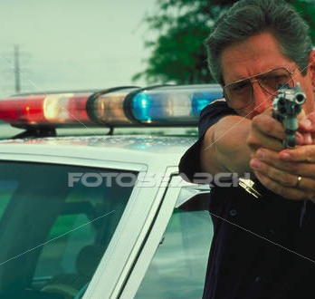
Police officers
Police officers face criminals, domestic violence, corruption… many lose their lives or are injured on the job.

Slide 11
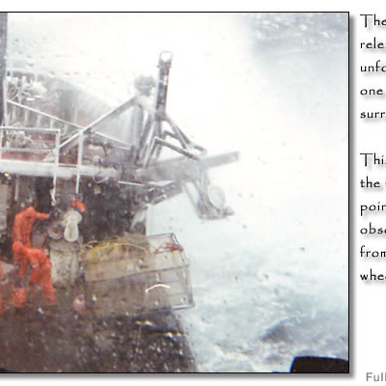
Fishermen
Fishermen face stormy seas and unreliable equipment. Many loose their lives by falling overboard or drowning.

Slide 12
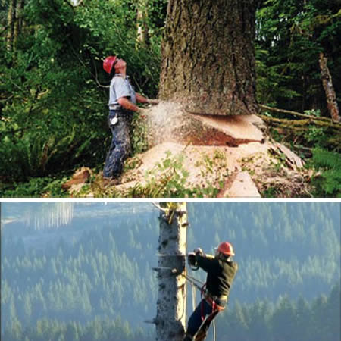
Loggers
There are many ways to get hurt. Loggers can get crushed when trees fall in the wrong direction. And help is always far away.

Slide 13
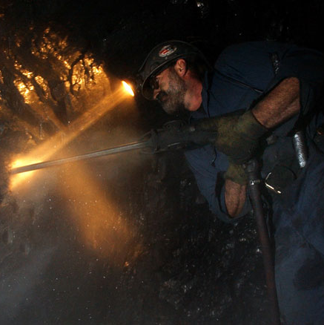
Miners
This profession takes lives when accident happens. Miners face many dangers every day. It’s such a hazardous job that miners wear emergency devices in order to give them enough time to escape a disaster.

Slide 14
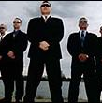
Body guards
Body guards serve as a human shield to very important persons.

Slide 15
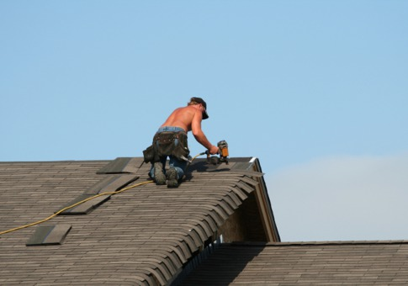
Top 10 Hazardous Jobs:
10-6
5-1
10. Bodyguard
09. Coast Guard Search and Rescue
08. Bomb specialist
07. Armored Car Guard
06. Policeman
05. Firefighter
04. Miner
03. Truck driver
02. Logger
01. Fisherman

Slide 16
Well done

